Slide 1
Using Raw Materials in Arkansas History
To accompany the Raw Materials Box
(Grades 3-5)

Slide 2
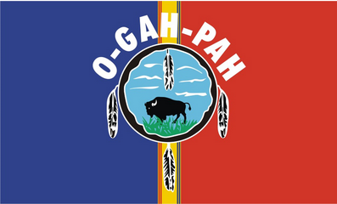
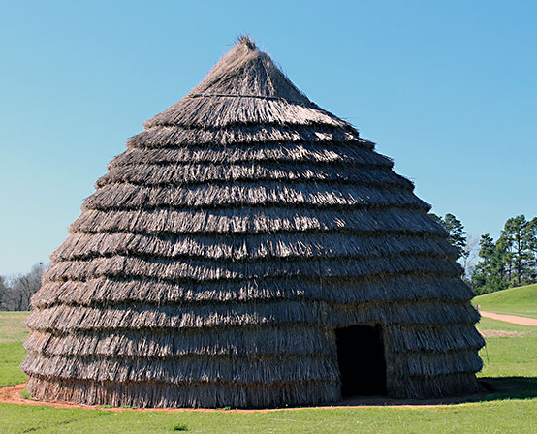
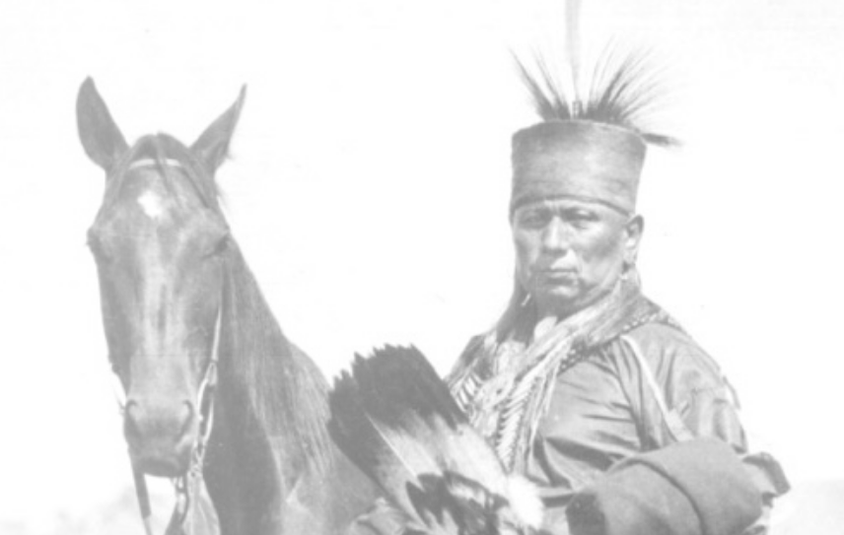
Native Americans in Arkansas
Quapaw flag
Name some Arkansas Native American tribes you have heard of.
Caddo, Quapaw, Osage, Cherokee, Tunica, Chickasaw, Choctaw
Where did they come from?
Prehistoric Indians from Mississippian, Woodland, and Archaic cultures.
But what were they like?
This is why we study history!
Caddo Roundhouse
From Osageculture.com
Notes:
Did you know that Native Americans lived in Arkansas for thousands of years before Europeans got here? (advance) Can you name any of the Native American Tribes or Nations that you have heard of? (Advance) Here are 7 Tribes that still exist today that either used to live in Arkansas or traveled through Arkansas during Removal. (Advance) Do you have any ideas about where these Native American groups came from? (Advance) Many of the Tribes had been in Arkansas for a very long time before they were forced to move west in the early 1800s, and some lived east of Arkansas and traveled through what is now our state toward Oklahoma. Some of them had different names at different times in history and we don’t always know what those names were. (Advance) Archeologists call these people Mississippian, Woodland, and Archaic cultures depending on how old they are. (Advance) What were these ancient Native American groups like? (Advance) Well, that’s why we study history!

Slide 3
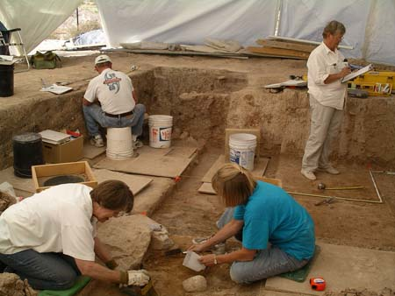
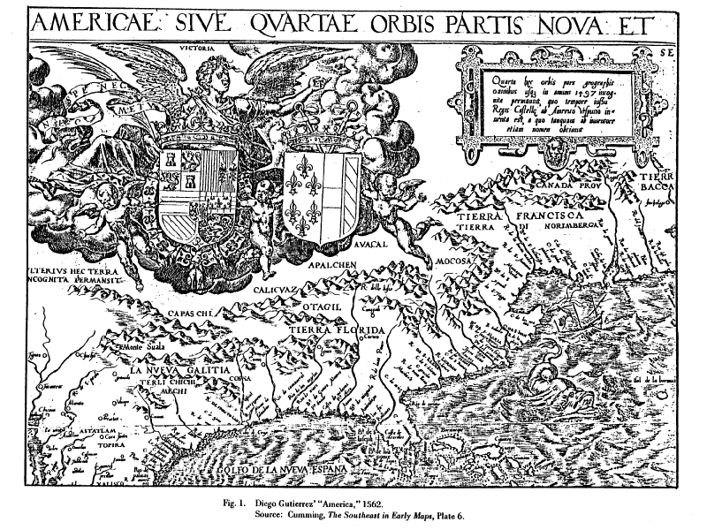
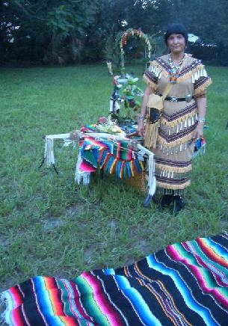
How do we learn about history?
3 kinds of sources:
Archeological
Historical
Ethnographic
All of these are somewhat weak by themselves so we use a combination of them when we can.
Notes:
So how do we learn about history? (Advance) There are 3 main ways that we find out about the past. (Advance) Archeological digs allow us to see and study the “stuff” that people left behind. It would be like if people went to your house when you weren’t there and looked at all of the things inside to try to figure out who you are. Do you think someone could figure you out based on your “stuff”? What if the person could only look at the stuff in your living room? Do you think they could figure out much about what you do and what kinds of things you like? (Advance) Historical research allows us to read what people wrote in the past. Sometimes this writing could be a person’s journal, but other times it could be a newspaper article that a person wrote about something they did not see in person. Would reading your journal tell the whole story of your life? Do newspaper articles always get all of the details correct? (Advance) Ethnographic research is when we talk to living people about how they live in the present, as well as their own history and stories, and memories that they have about or from their parents, grandparents, and great grandparents. Do you always remember all the stories about your family that your relatives tell you? (Advance) So even though each of these ways of learning are interesting, we need all three to really try to understand how people lived in the past. I’m going to take you through a quick timeline of Native American history in Arkansas and then we’ll talk about how archeologists understand the artifacts that they left behind.

Slide 4
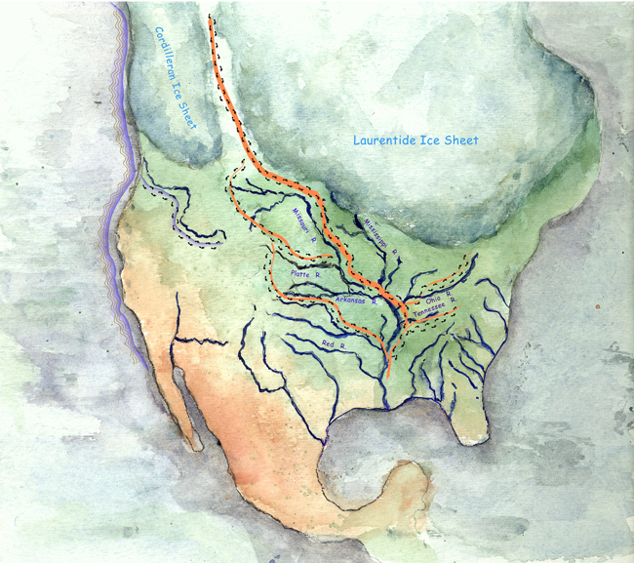
People arrive in Arkansas around 12,000 – 13,000 years ago!
Notes:
People crossed the Bering Straight from Asia and then moved down an opening between glaciers in what is now Canada to get to what is now the United States about 12,000 years ago. They also probably traveled south along the coast. From there, people spread out across the landscape.

Slide 5
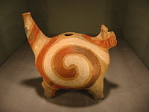
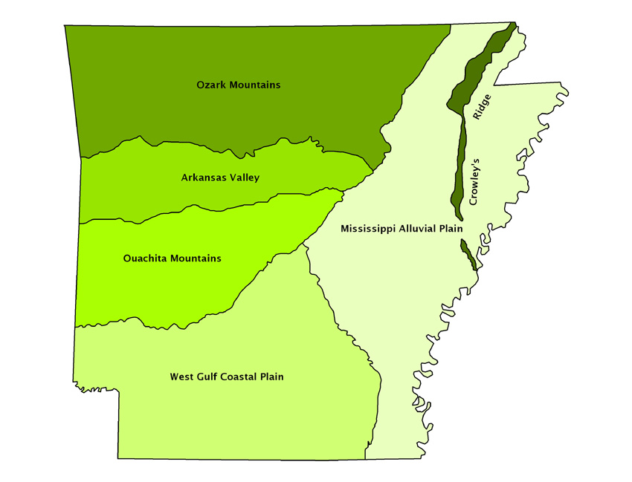
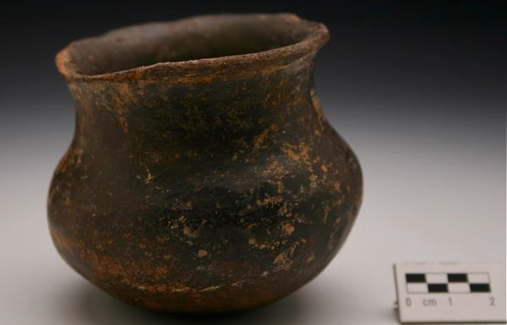
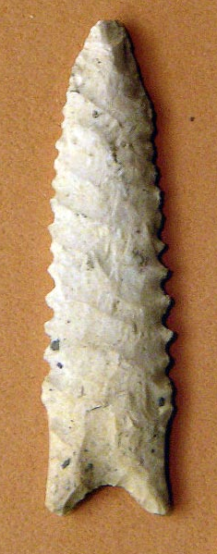
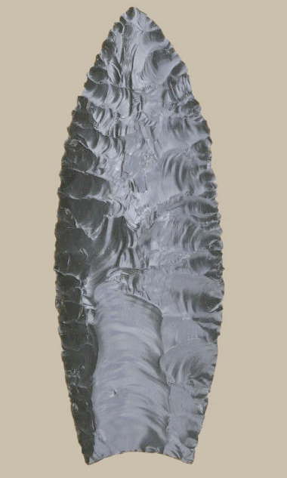
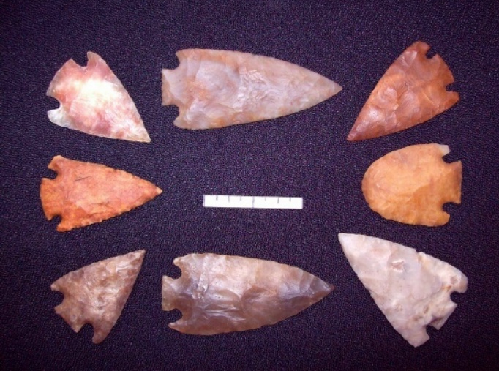
The Pre-Contact Cultures of Arkansas
Paleoindian
Dalton
Archaic
Woodland
Mississippian
Names WE use for cultures
Separated by ways of life and cultural characteristics
Notes:
In Arkansas we have archeological evidence of people living here as long ago as about 11,500 -8500 BCE. (Advance) These first inhabitants of Arkansas are called Paleoindians by archeologists (Advance) and they made spearpoints like this one and followed big game across the landscape to hunt. (Advance) The next archeologically identifiable group are the Dalton people. (Advance) They made spearpoints differently than the Paleoindian people before them, but they were similar, leading archeologists to believe that these were likely descendants of the Paleoindian people. They lived in Arkansas from 8500-8000 BCE and also hunted large mammals. (Advance) After the Dalton period is the Archaic period, from about 8000-1000 BCE. (Advance) During this time period different groups of people seem to have developed different spear point making processes and we find a variety of tool types in different areas of the state. People also traveled to different areas at different times of the year to use the natural resources that were available. They even started gardening. (Advance) In the Woodland period, from 1000 BCE to 1000 CE, people began to live in small villages for the whole year rather than traveling around. (Advance) They kept gardens where they domesticated plants, began making pottery for cooking and storage, and began using the bow and arrow to hunt animals like deer. (Advance) The Mississippian period is from 1000 CE to 1541 CE, when Hernando de Soto’s expedition crossed the Mississippi River into what is now Arkansas. (Advance) The Mississippian people of Arkansas were large-scale farmers, lived in large cities, made beautifully decorated pottery, and used bows and arrows for hunting. People lived slightly differently in different regions of Arkansas, but these are some of the main features of the Mississippian period across Arkansas.

Slide 6
The Pre-Contact Cultures of Arkansas
Paleoindian
Dalton
Archaic
Woodland
Mississippian
Names WE use for cultures
Separated by ways of life and cultural characteristics
Notes:
Even though archeologists call these cultures by these names now, it is important to remember that we do not know what they called themselves. We also do not know their thoughts and feelings or how they may have interacted with each other through all of history. We only see the artifacts that they left behind and try to figure out how they made them and how different people changed the way things were made through time. We must also remember that all of these changes happened over thousands and thousands of years and people’s ways of life and the characteristics of their cultures changed during that time along with the resources that they had available to them in the environment.

Slide 7
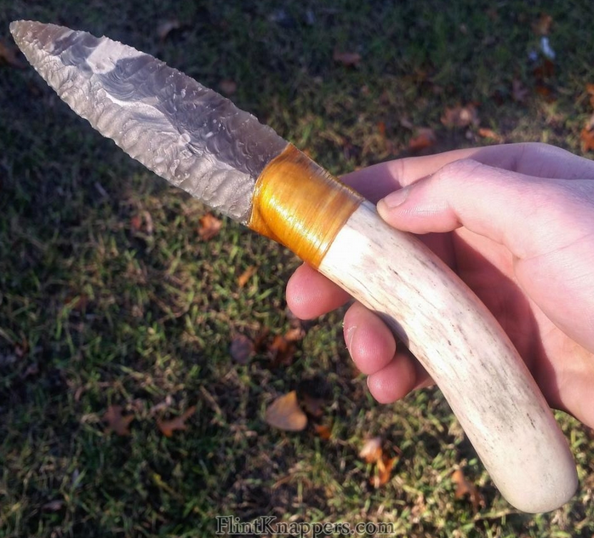
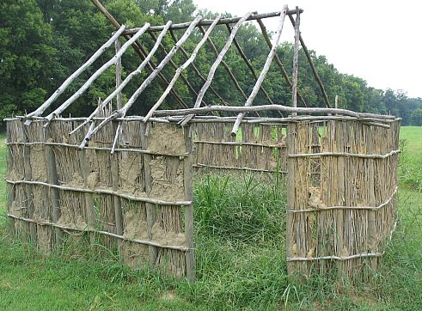
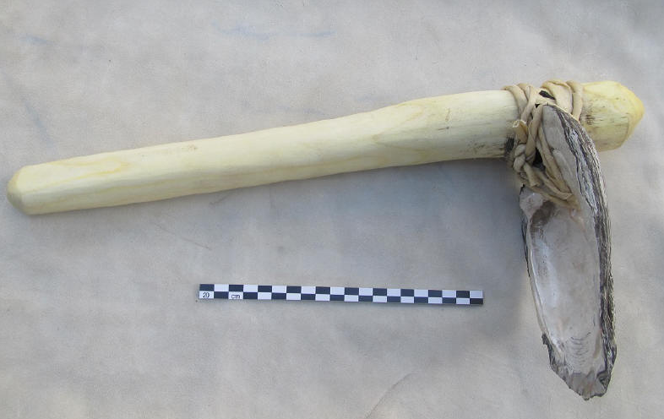
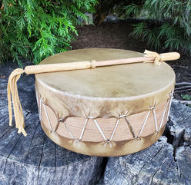
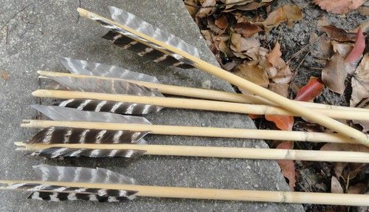
Archeology
Look at things people leave behind
What kinds of things do you have and where did you get them?
Where did Native Americans get things?
They found the Natural Resources and made them.
Notes:
Today we are going to focus on the archeology part of learning about history. Archeologists use the things that people leave behind to try to learn about how people made things and did things in the past. Where do you get the things that you use in your daily life? Where do you think that Native Americans at different times in the past got the things that they used in their daily lives? Could they go to the store and just buy the things they needed or wanted? Nope. They had to find the Natural Resources that they needed to make their own things out of raw materials. They usually found these raw materials in the areas around where they lived. So people in different parts of the world made similar things out of different materials and sometimes did things very differently from each other based on the Natural Resources that they had available.

Slide 8
Activity
What do you have?
What is it made of?
Where did it come from?
What could it have been used for?
Notes:
In this box we have a bunch of the kinds of Raw Materials or Natural Resources that would have been available to Native Americans in Arkansas. I’m going to put you into groups and give you a Natural Resource. You and your group are going to try to figure out what you have. What is your resource, what is it made of, where did it come from, and what could Native Americans have used it for? (note: This last question can be left out if time doesn’t permit or if the students are too young to draw these conclusions.) (After students have had time with their resources, the following slides will explain the resources and their use. Many of the Raw Materials also have at least one example of a finished product made from the material in the box that the students can look at and touch as well.)

Slide 9
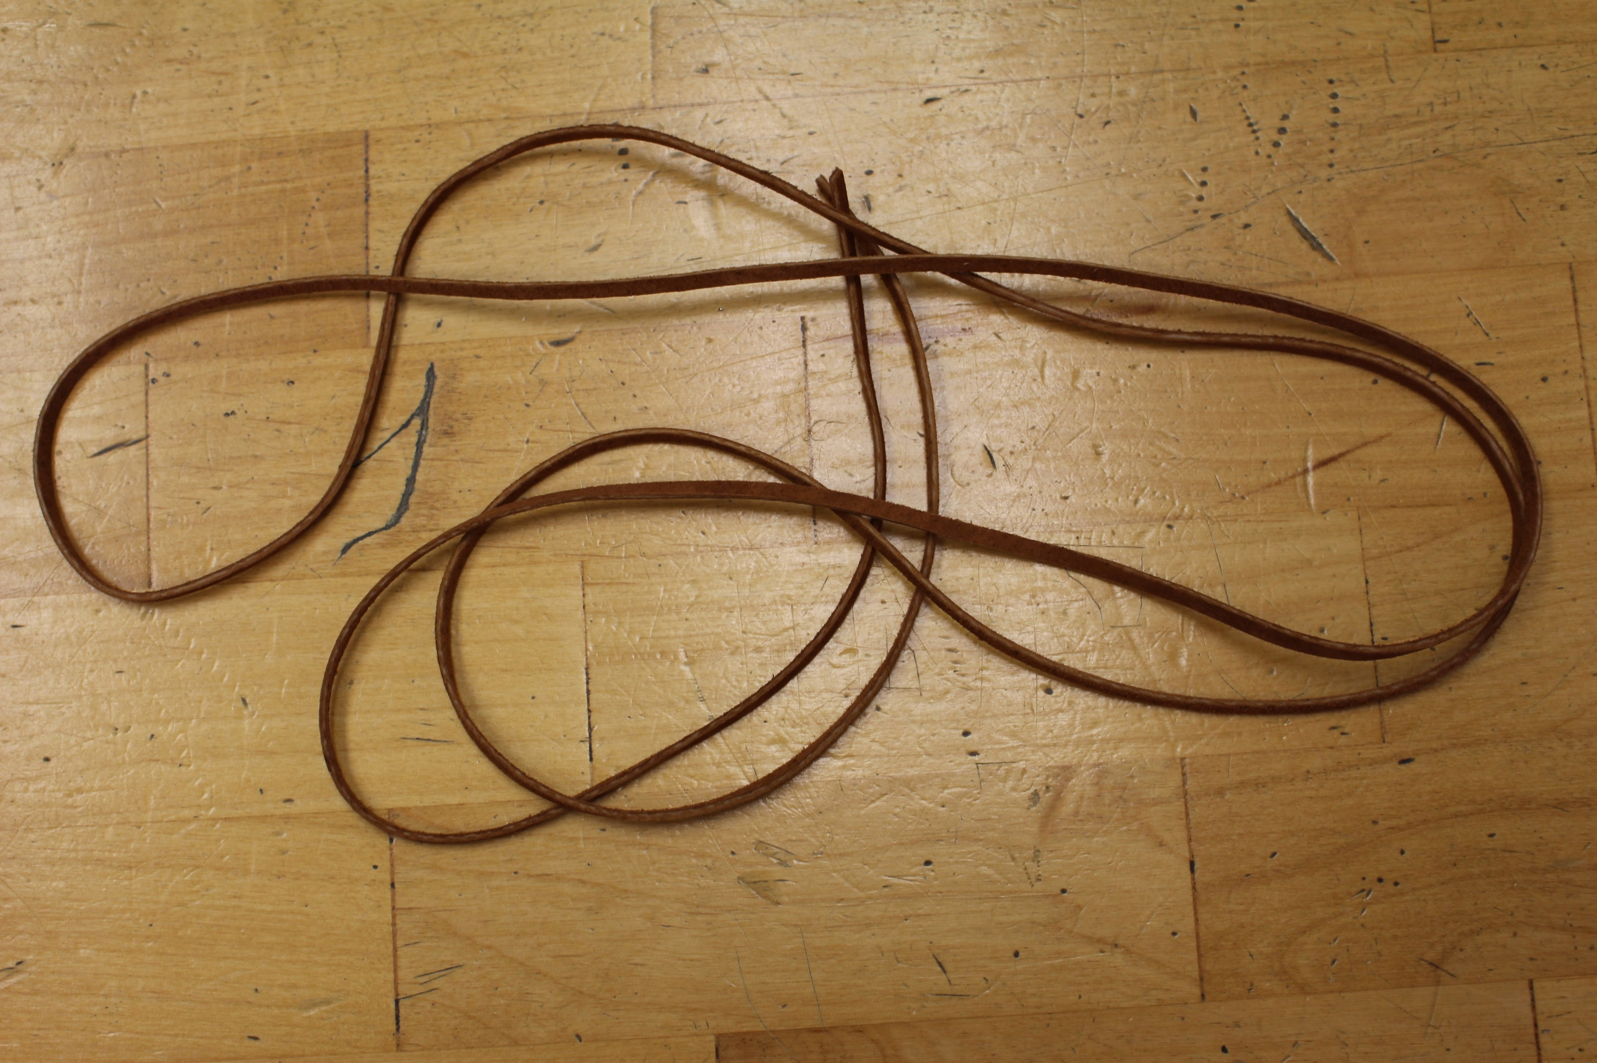
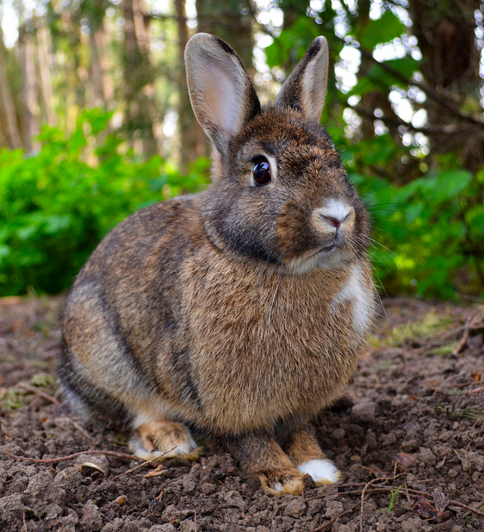
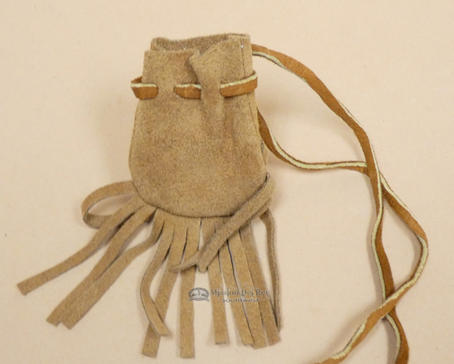
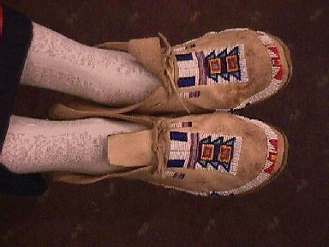
Rabbit Skin
In Box
Leather strip (in box)
Rabbit
Leather bag
Leather on Drum
Moccasins
Notes:
Rabbits live in deserts, swamps, marshes, forests, grasslands, and prairies. So they are found in most places that people would live, making them a useful Natural Resource. Rabbit skins (or deer or other mammal skins) can be processed into leather and then used to make clothing and shoes as well as straps for musical instruments. The leather strip in the box is an example of the strip that could be used on a drum, to tie shoes, or to secure bags.

Slide 10
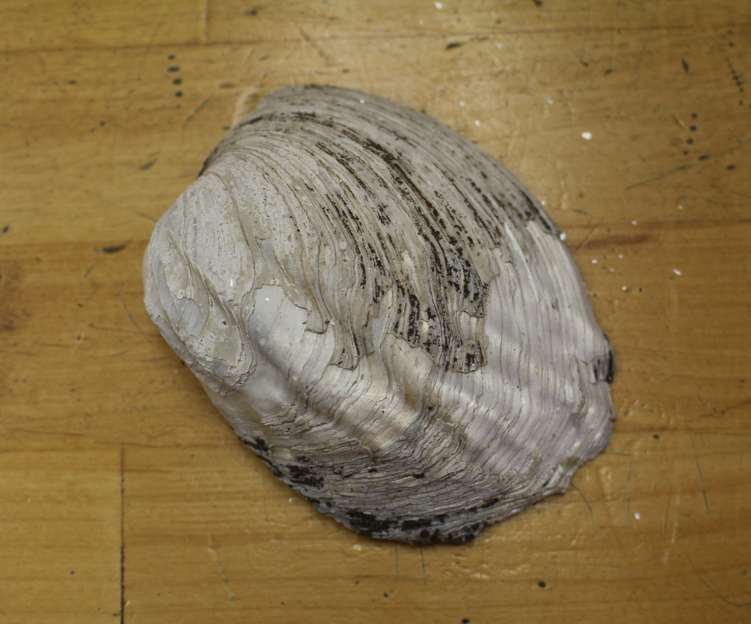
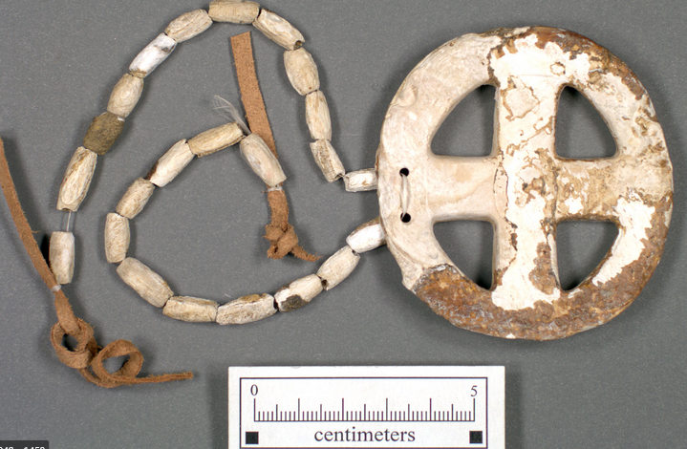
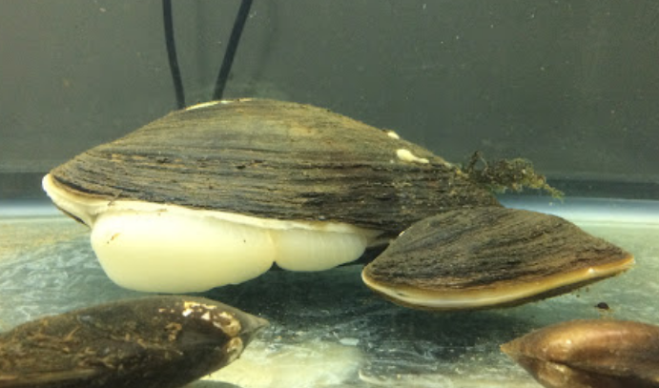
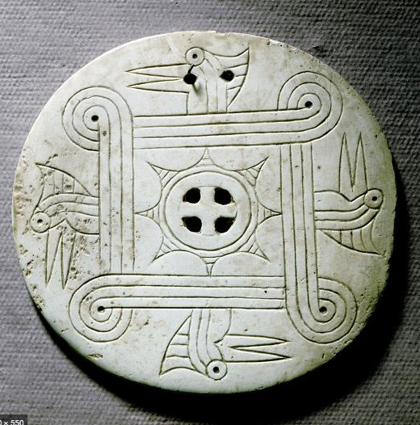
Mussel Shells
In Box
Mussel sticking out of shell
Gorget and Beads
Gorget
Shell Hoe/Digging Tool
Bead (In Box)
Notes:
Mussels live in freshwater (streams and rivers) in the sand and gravel at the bottom. They live in water all over Arkansas. The animal inside can be eaten and the shell can be used to make tools or jewelry. Native Americans made digging tools, or hoes, out of the shell to work in their gardens. They also made beads for necklaces and decorations for their clothes, and gorgets, which are carved shells that were worn around their necks like necklaces.

Slide 11
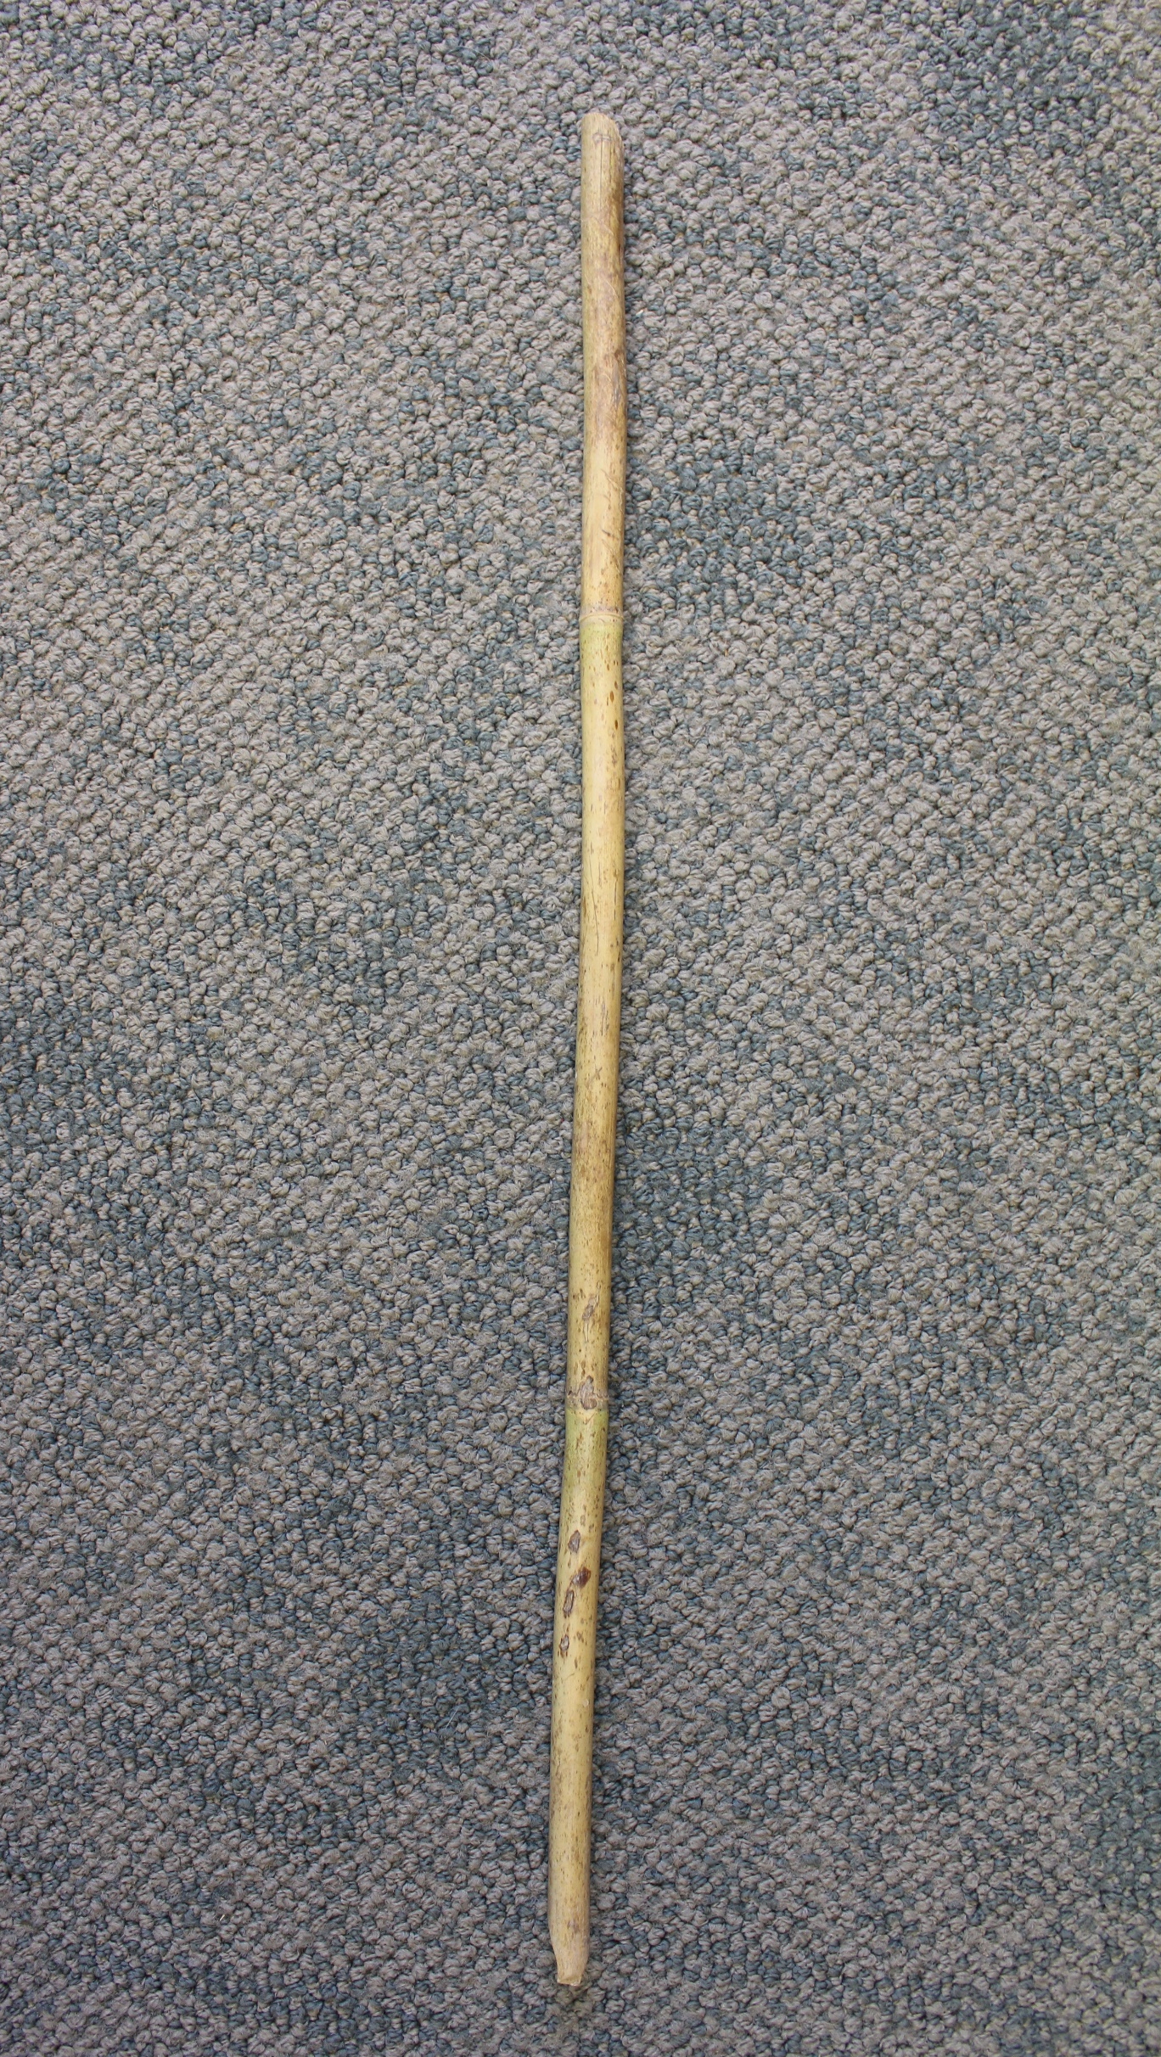
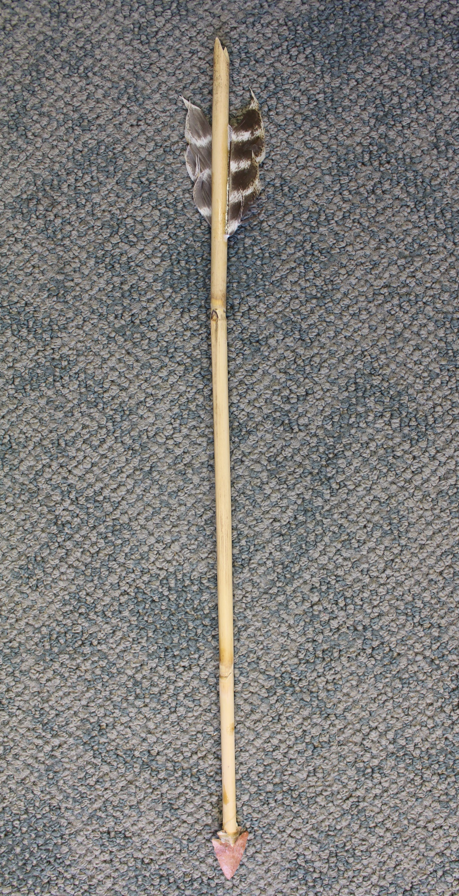
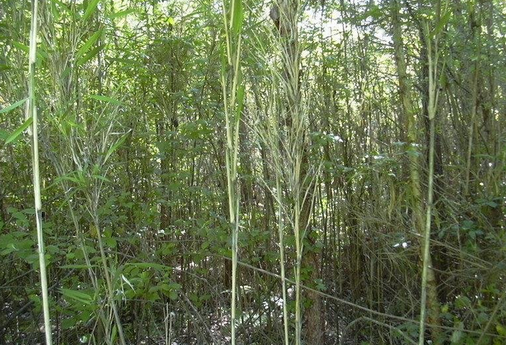
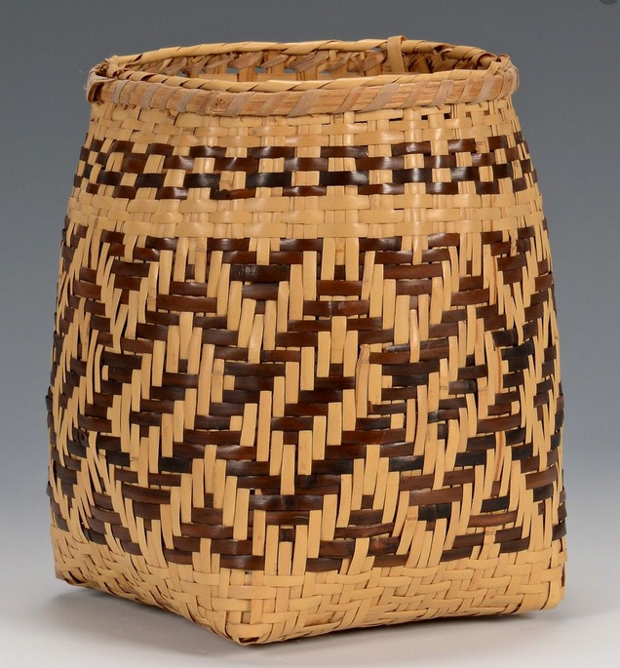
River Cane
In Box
Arrow
(In Box)
Basket
Mississippian House
Notes:
River cane grows on floodplains, bogs, pine barrens and savannas. Mostly in places where it can get a good amount of water. Native Americans used cane for many purposes and changed it in amazing ways. They used the cane shafts themselves to construct arrows and house walls, and also broke down the cane into thin sections in order to make it flexible and soft enough to weave baskets.

Slide 12
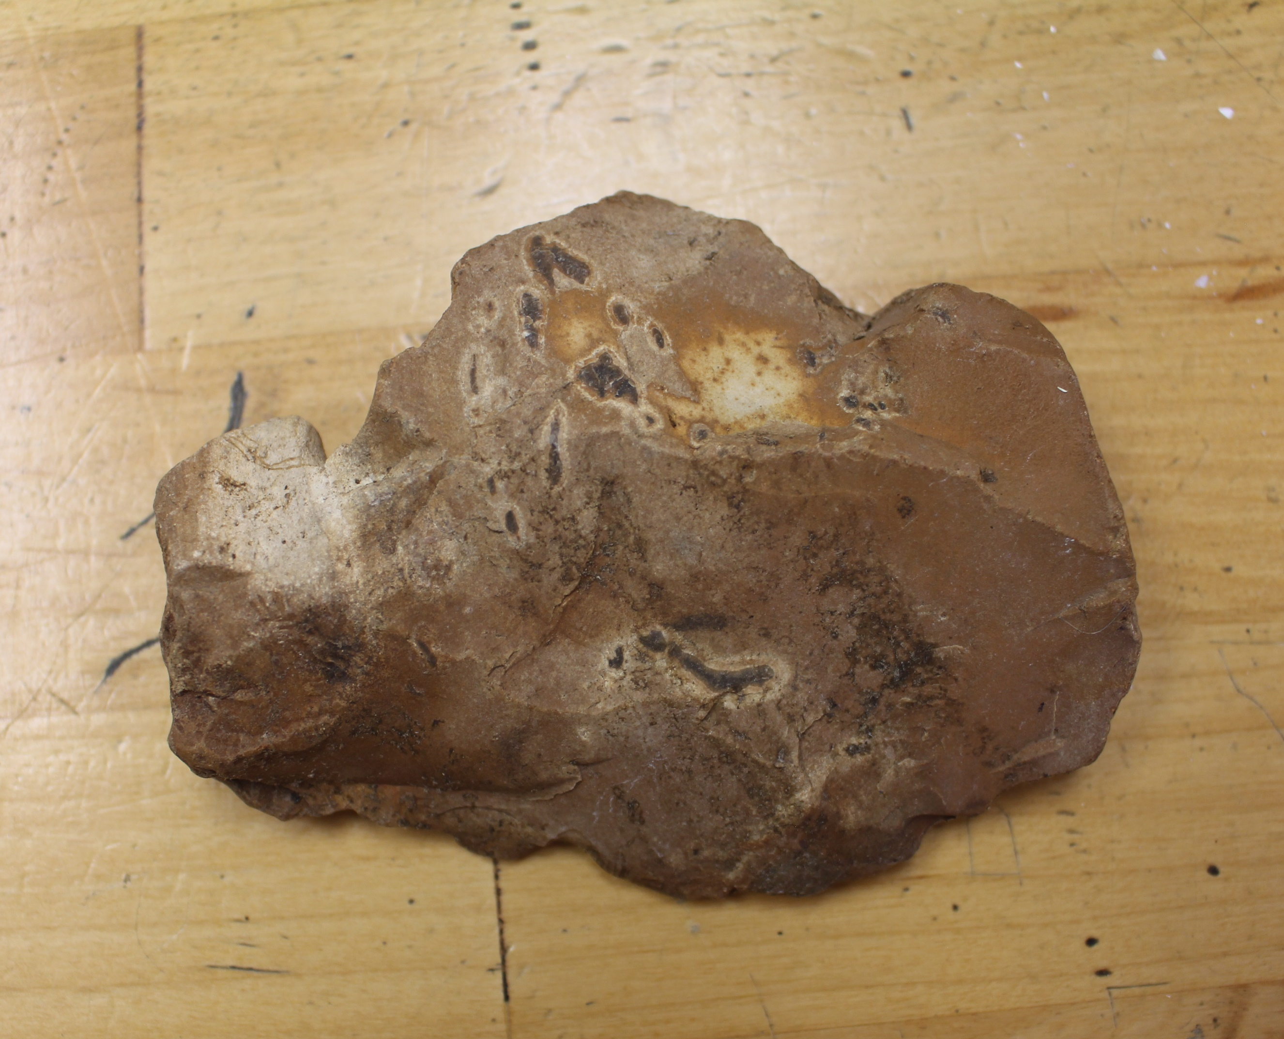
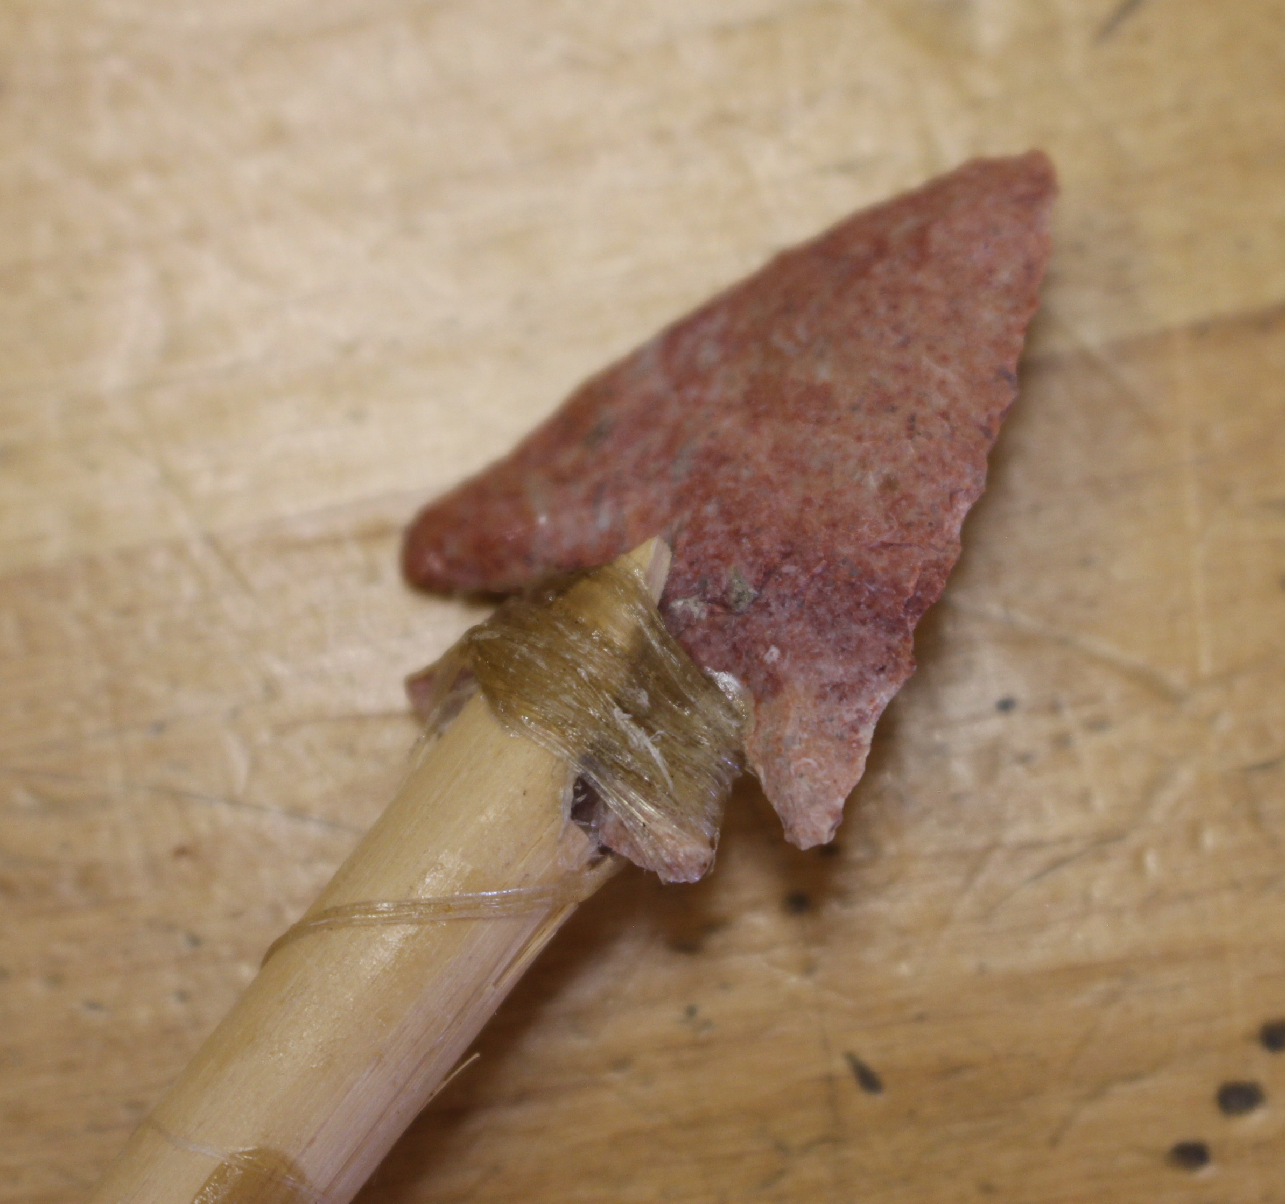
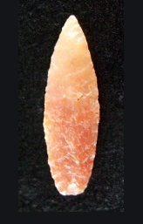
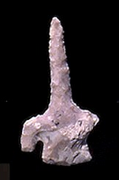
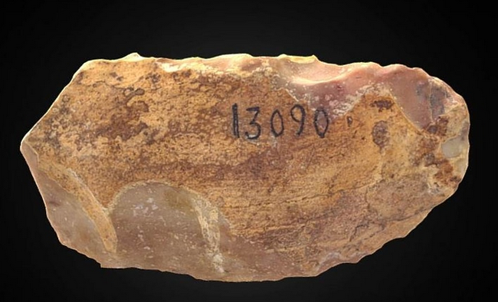
Chert
In Box
Arrow Point
(In Box)
Arrow Point
Drill
Scraper
Notes:
Chert is a kind of rock that is found all around Arkansas. It can be found on bluff faces, or on gravel bars in rivers. It can sometimes be found in fields as well. Chert can be made into many tools. Arrowhead are what most people think of when they think of Native American artifacts, but Native Americans also made drills and adzes (or axes) out of stone. And even made scraping tools to clean animal hides.

Slide 13
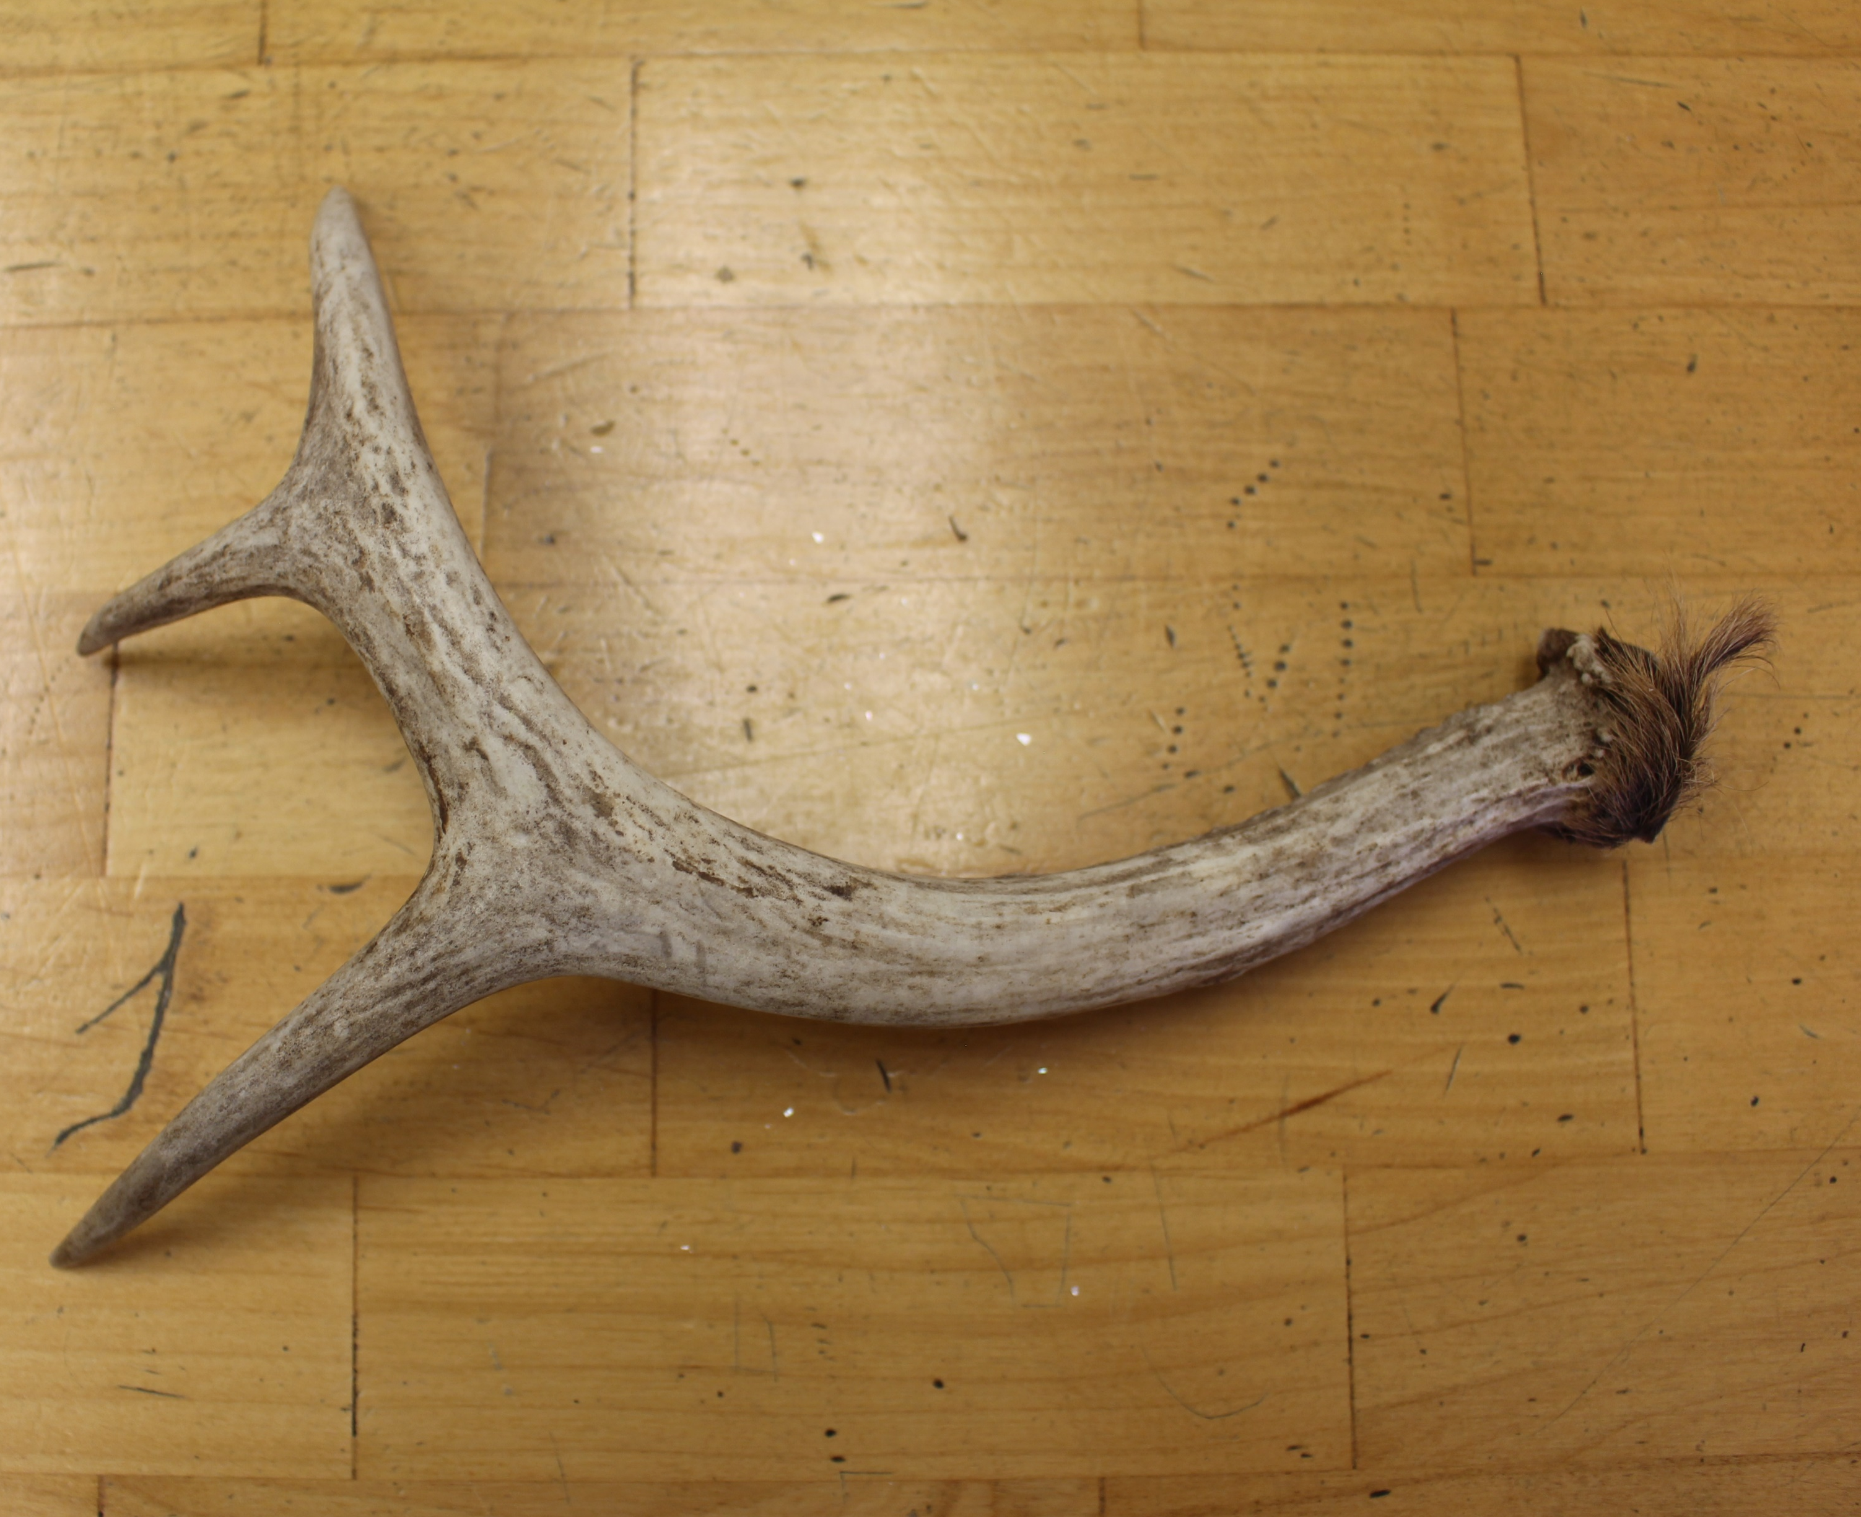
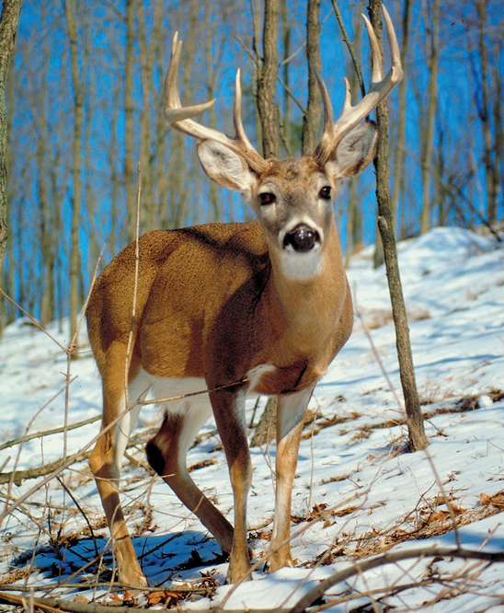
Deer Antlers
In Box
Knapping Tool
Antler Point
Knife Handle
Notes:
Deer live in wetlands, forests, grasslands, and mountains, so they are found in many places that humans have lived throughout time in Arkansas and North America. Deer start to grow their antlers in the spring and then shed them (the antlers fall off naturally) in the winter. Sometimes you can find antler sheds in the woods if you pay close attention. Native Americans used deer antlers for a variety of tools. They could make the antlers into handles for the stone tools that they made out of chert, they could use the tips of the antlers to help to chip the edges off of the chert to make blades (knapping) and they would sometimes sharpen the point of the arrow to make a pointed tool like an arrow tip.

Slide 14
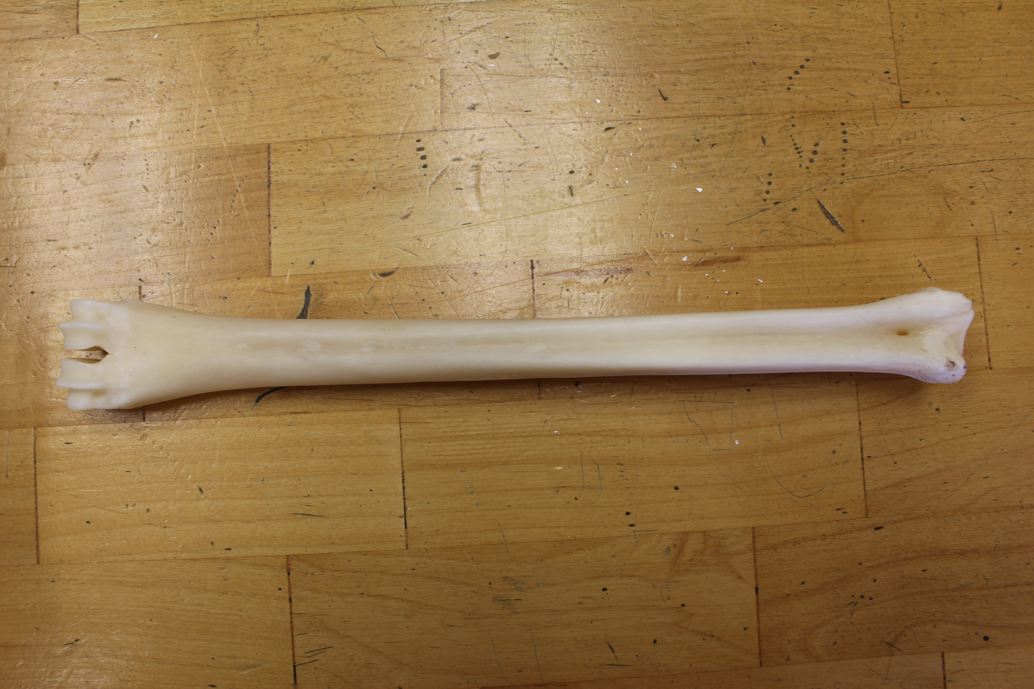
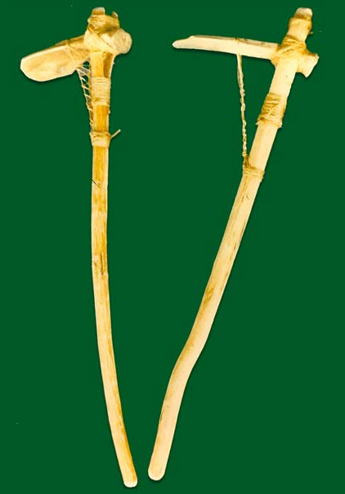
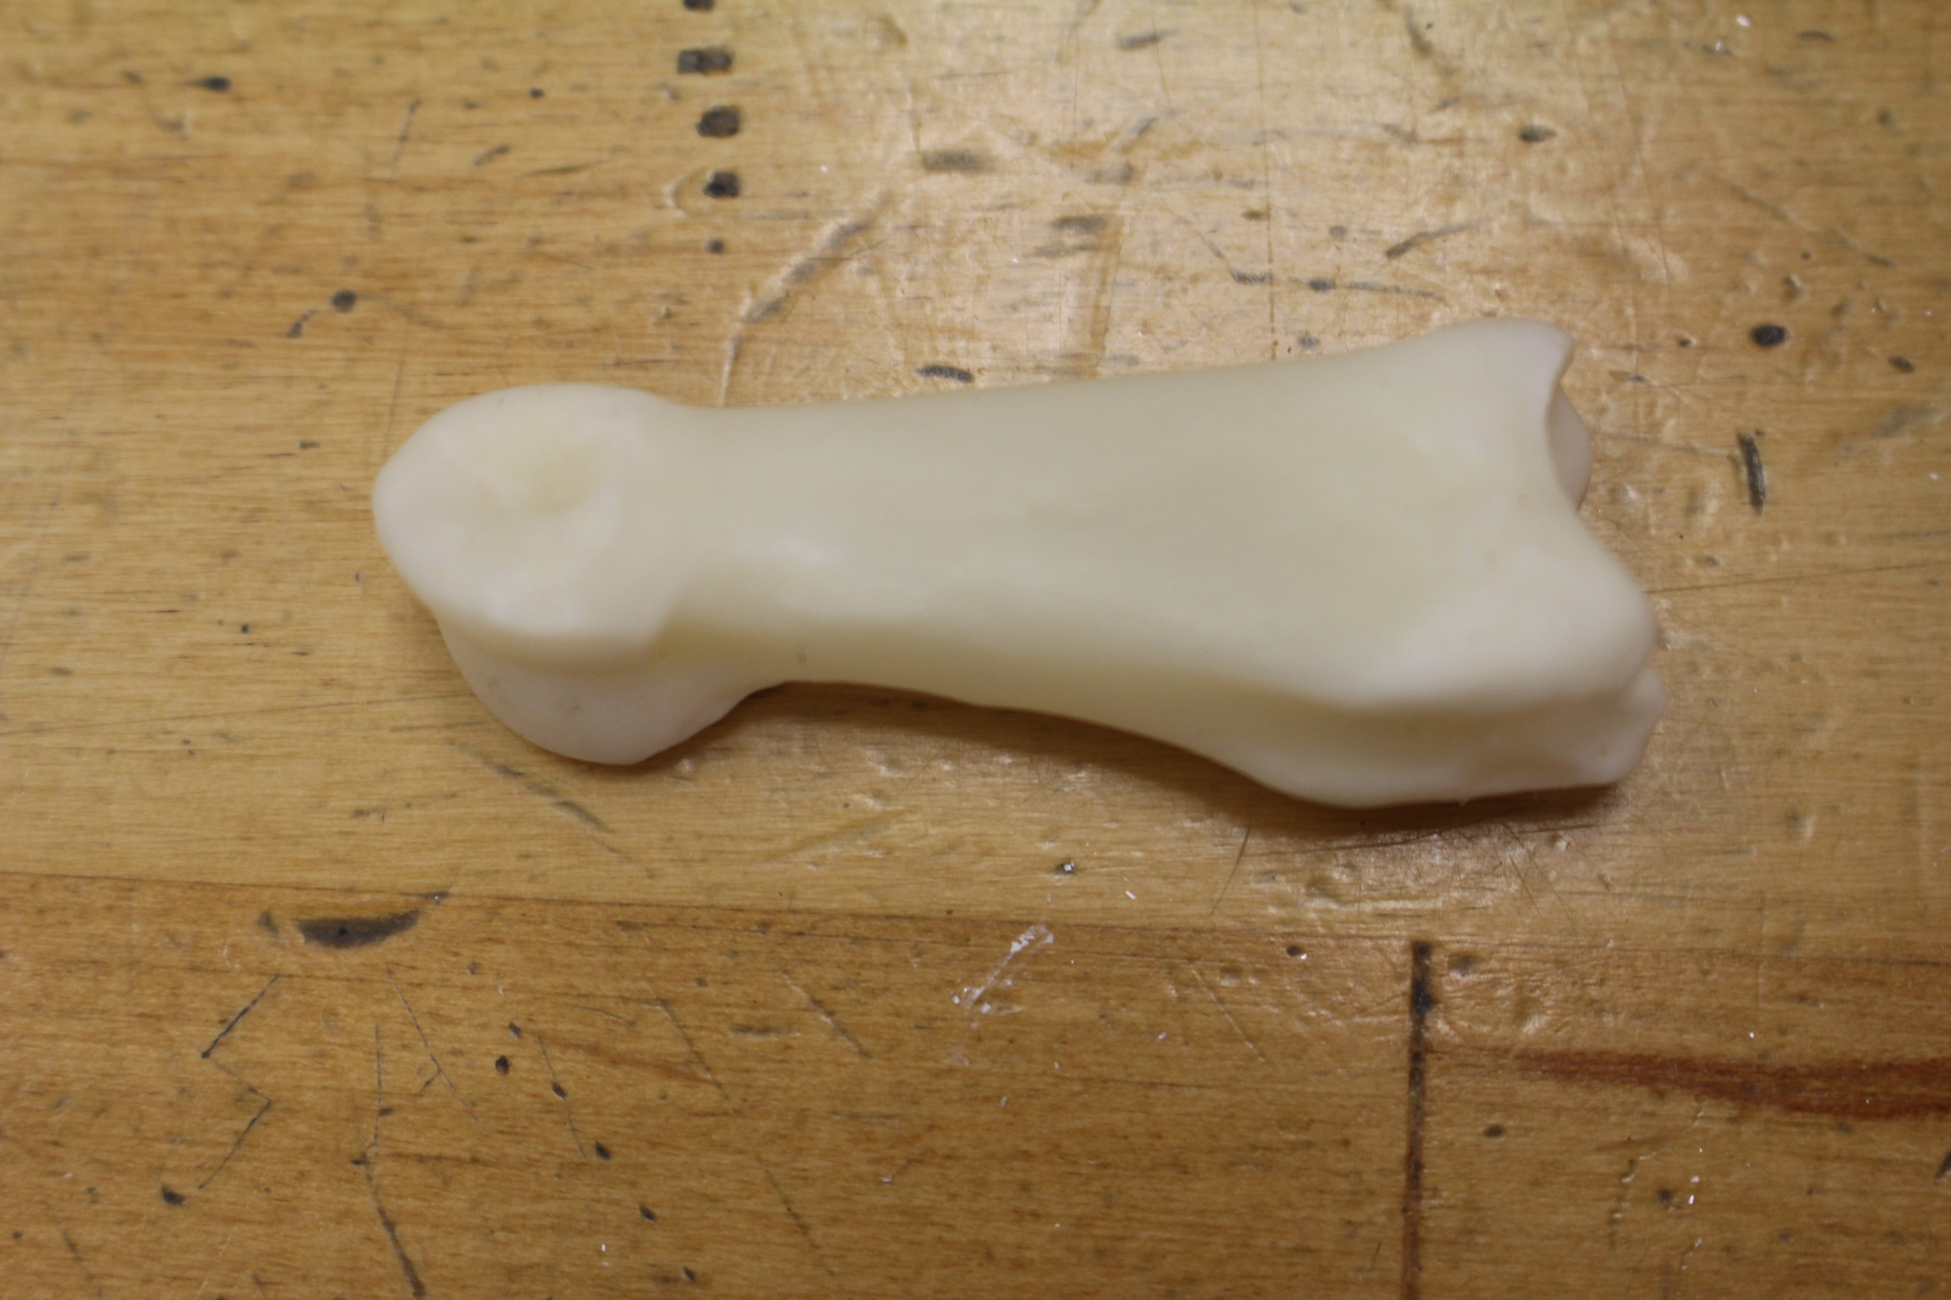
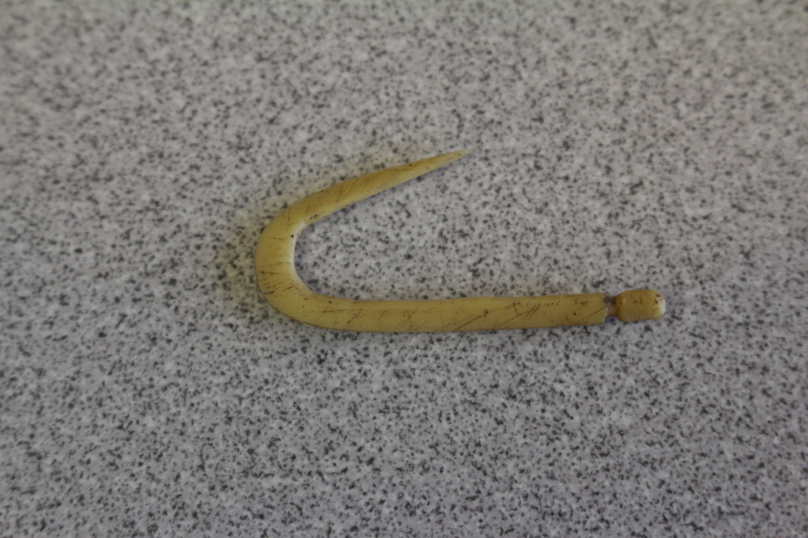
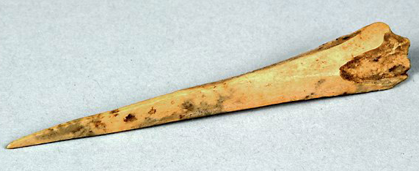
Deer Bones
Lower Leg Bone (In Box)
Toe Bone (In Box)
Hoe/Digging Tool
Fish Hook (In Box)
Awl
Notes:
Deer bones are also useful for making tools. Bones are very hard, so they make strong tools. Native Americans made fish hooks for fishing, hoes or digging tools for working in their gardens, and awls, which are pointed tools, to punch holes into leather to make clothes and shoes.

Slide 15
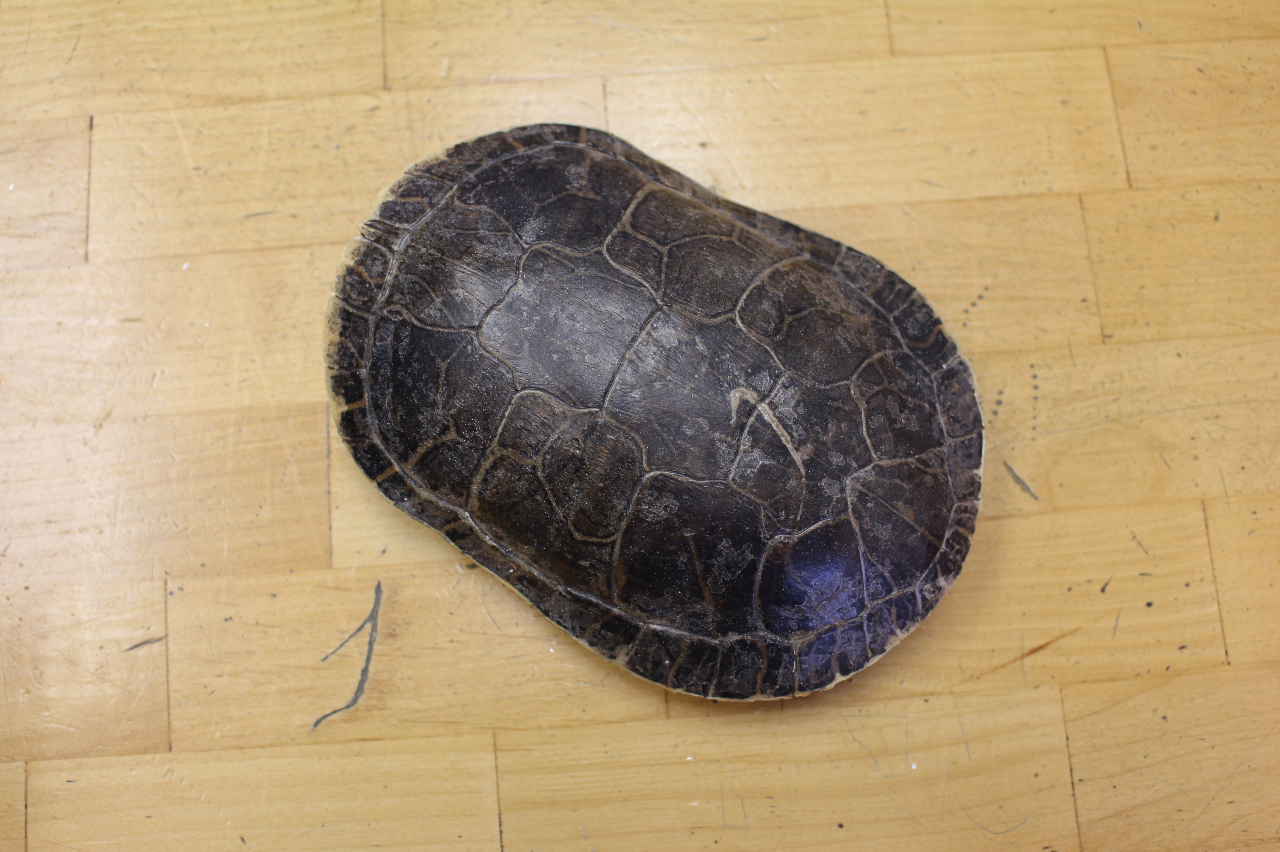
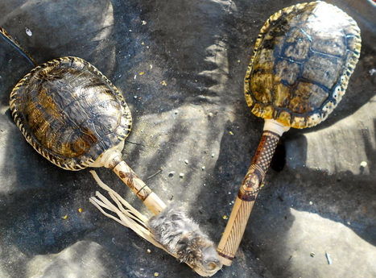
Turtle Shells
In Box
Shell Rattle
Notes:
Turtles can be found in ponds and lakes all across Arkansas and many places in North America. Tortoises (which are very similar to turtles) live in swamps, ponds, lakes, and rivers. So like deer and rabbits they are found around most places that humans would live. Turtles can be eaten, and their shells can then be used in other ways. Sometimes they could be used as bowls to store or serve food, and sometimes the shells could be filled will small bones, gravel, or clay to make them into rattles.

Slide 16
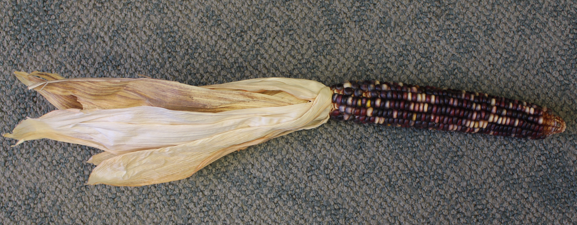
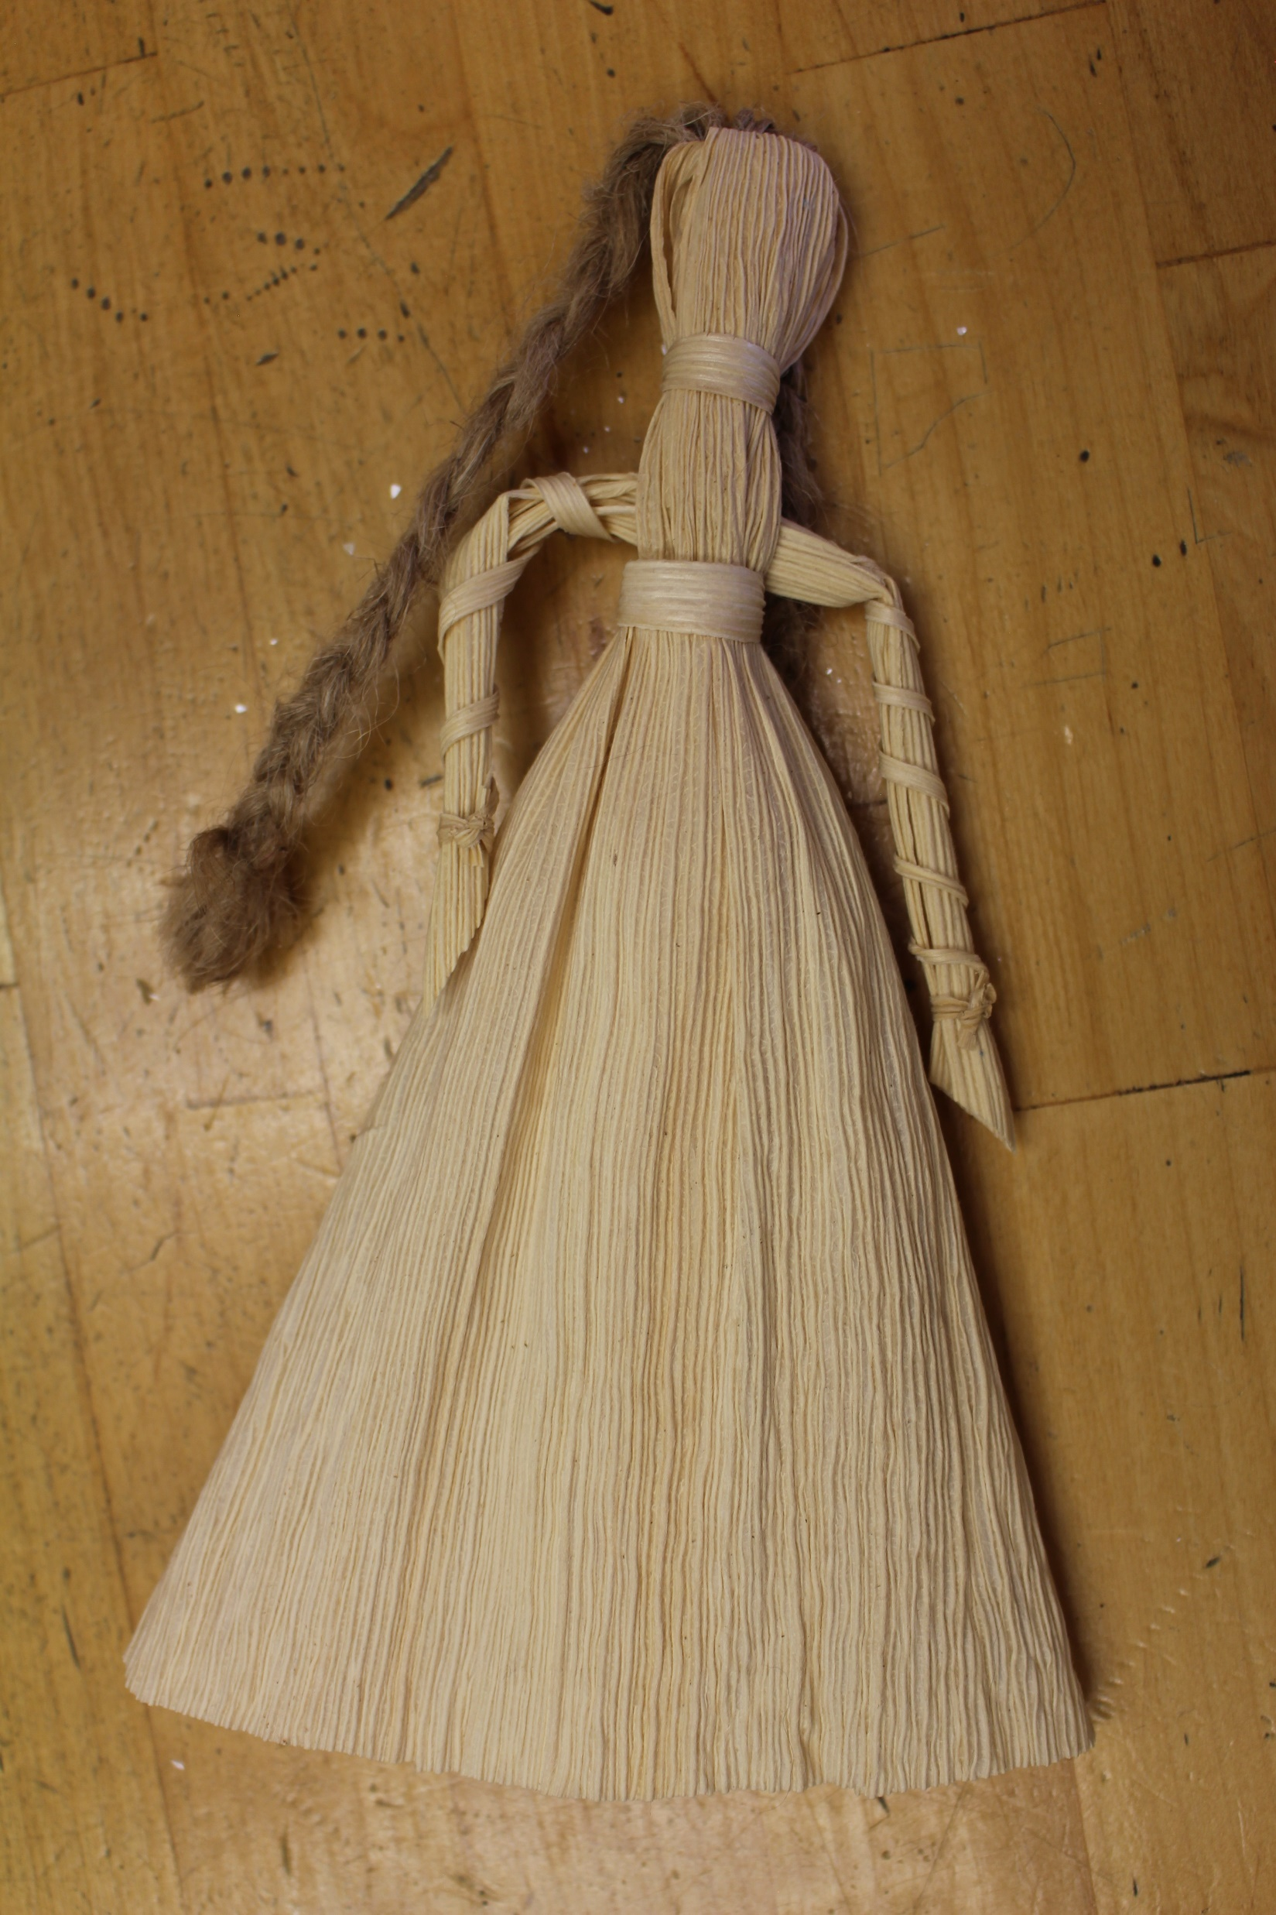
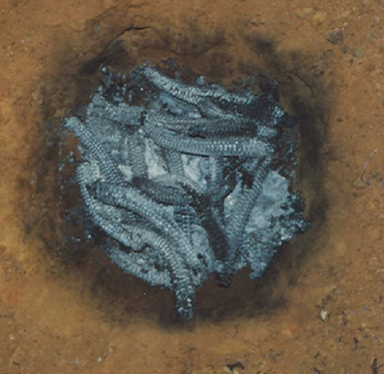
Corn
In Box
Burned Corn Cobs
Cornhusk Doll (In Box)
Notes:
Native Americans have been growing corn in gardens and huge fields for about 1000 years. Corn can be eaten straight off the cob or ground down into flour to make bread. The husks of the corn can be used to make dolls and the cobs can be burned in small pits to create smoke to keep mosquitos away.

Slide 17
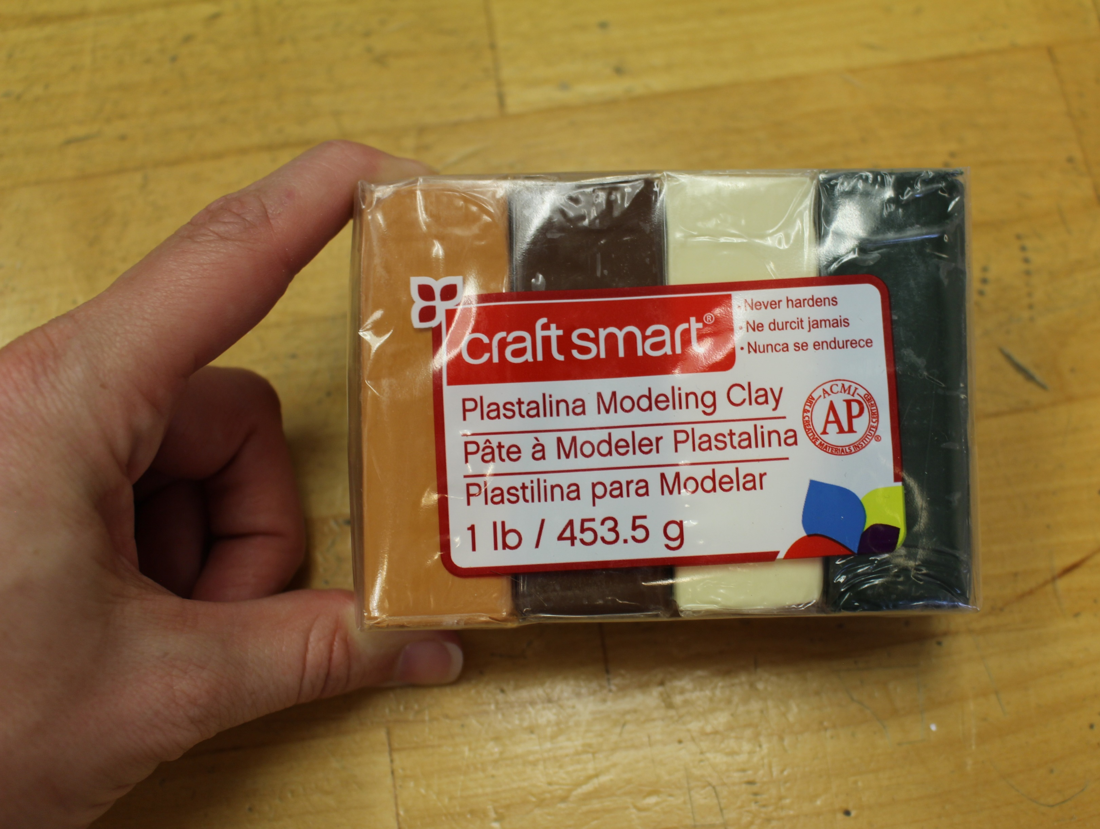
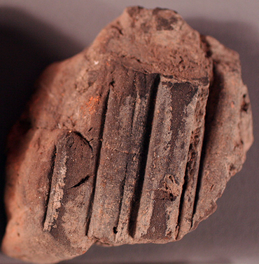
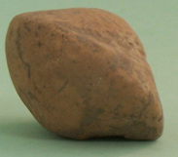
Clay
In Box
Daub (In Box)
Poverty Point Object
Mississippian House
Pottery
Notes:
Native American people in Arkansas used clay for a variety of things. They used it for cooking by making it into bowls and jars and things called Poverty Point Objects. Poverty Point Objects were pieces of clay that they heated up in a fire and then put directly into a bowl of soup to heat it up. They also used it to make a lining for the walls of their houses called daub. The daub helped to keep the house walls insulated from wind and rain.

Slide 18
Gourds
Bowls, scoops, and dippers (in box)
Roasted Seeds
Seeds (In Box)
Whole gourd (in box)
Notes:
Native Americans grew a variety of different types of gourds. Gourds come from South America and grow really well in the soils and heat of Arkansas. Depending on the type, Native Americans could eat the inside and roast the seeds (like roasted pumpkin seeds you make at Halloween). Some gourds could be dried out and then cut open to make bowls, spoons, and scoops.

Slide 19
Sumac
Tea
Dyed Fibers
Dried Sumac (bagged in box)
Notes:
Sumac is a weed that grows all over. It likes to live in loose dirt like recently plowed fields. Sumac is a plant that Native Americans used for tea, medicine, and dye. The dye and tea are made when with fresh sumac berries. The berries in the bag are dried and won’t make a good tea or dye anymore.

Slide 20
Natural Resources Now
Arkansas is the Natural State
It is still full of natural resources
Many products are still grown/manufactured
Notes:
Arkansas is known by the nickname “The Natural State” and it is full of natural resources even to this day. If you walk in a State Park or other natural area you can see many of the ones we’ve talked about today still around. And even though most of us don’t make our own tools, construct our own houses, and grow most of our own food anymore, there are industries in Arkansas that do many of those things for us using our natural resources. Think about paper mills in southern Arkansas using trees, farmers in eastern Arkansas growing crops, and chickens and other poultry being raised in western Arkansas, among others. What other natural resources can you think of that are still in use today in Arkansas?

